Slide 1

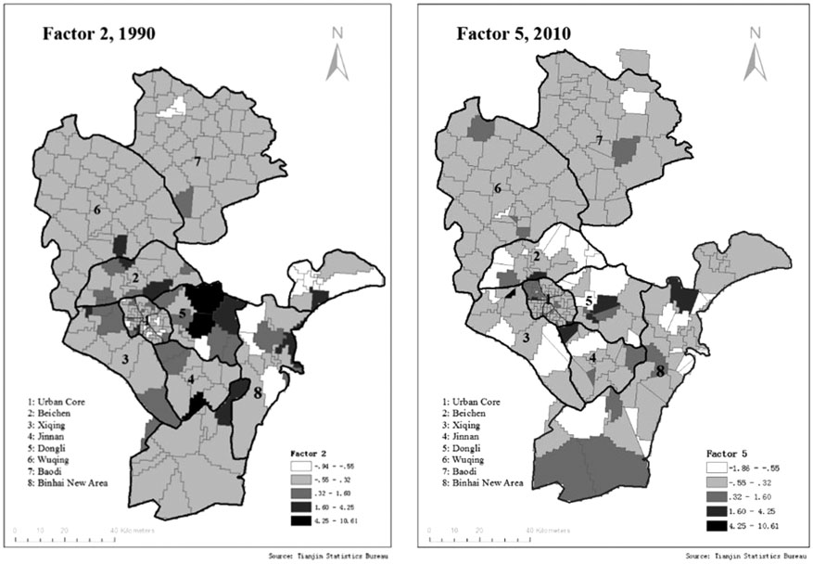
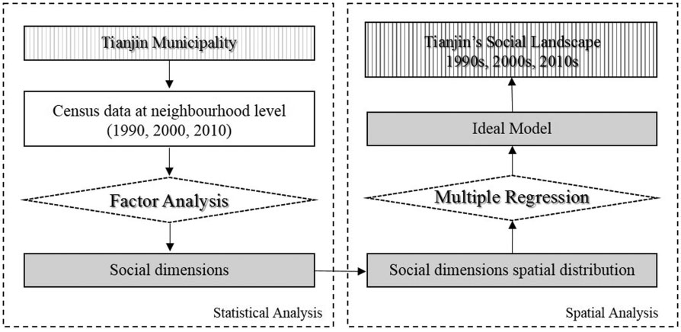
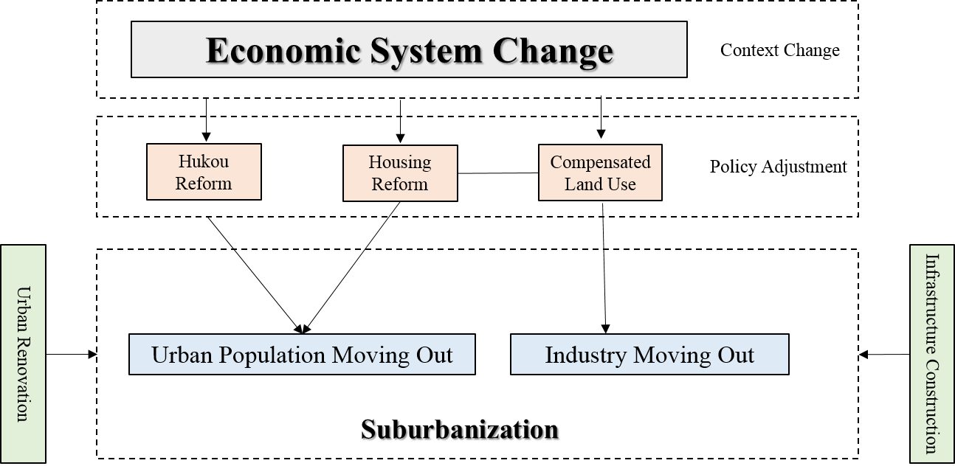
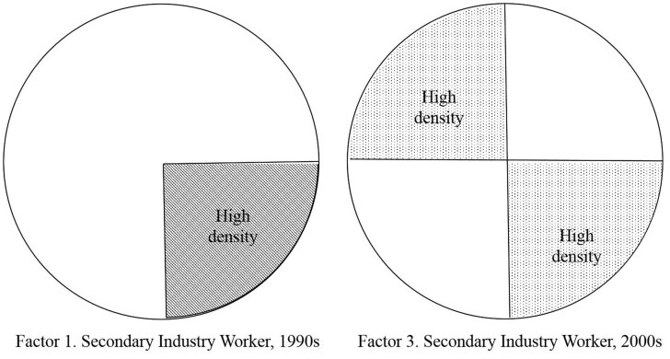
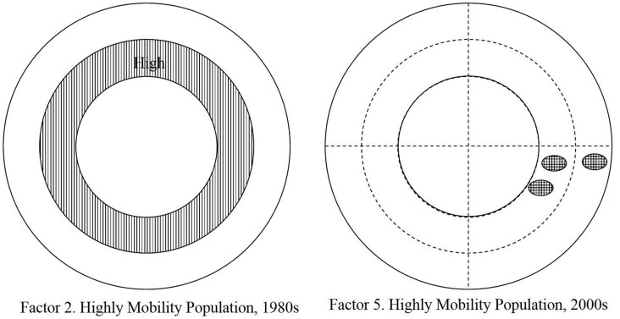
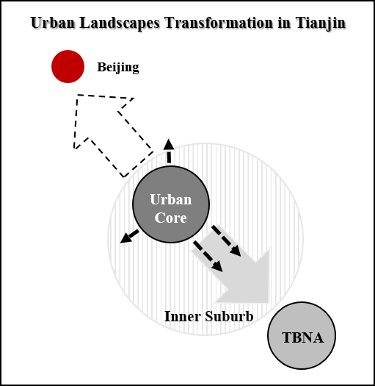
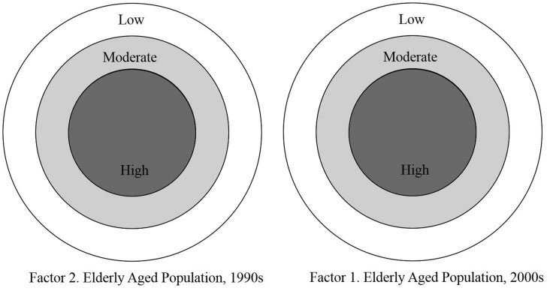
Spatio-temporal Urban Social Landscape Transformation
in Pre-new-urbanization era of Tianjin, China
Ziwei Liu & Huhua Cao
Department of Geography, Environment and Geomatics, University of Ottawa, Canada
Introduction
Tianjin has seen dramatic changes in its social landscape since China’s economic reforms of 1978. Given this context, this study aims at understanding the different urban socio-spatial patterns of Tianjin and their mechanisms in three distinctive economic contexts by adapting both statistical and spatial approaches.
Methodology
Data resources: The 1990, 2000 and 2010 Tianjin censuses at the neighborhood level; Tianjin’s Year Books from 1980 to 2013, GIS data from China Data Online
Variable selection: population and demographic structure, family structure, marital status, mobility, education leave, occupation, economic status, ethnic minority.
Research Flowchart
The social dimension representing ‘‘highly mobile population’’ has a light social diﬀerentiation. However, generally speaking, it is still can be concluded that the neighbourhoods with relatively higher factor scores are located in the Inner Suburb. While during the 2000s, the spatial pattern of the high mobile population also had a light social diﬀerentiation with a scattered Inner Suburb. The distribution of this factor is more balanced in the Outer Suburb and the Urban Core than in the Inner Suburb and the TBNA. Compared to its distribution in the 1980s, there tends to be a greater concentration toward the northwest part of the Urban Core. The population changes are the most obvious in the Inner Suburb.
Discussions
Results
A distinctive “dual-core” city
In addition to the traditional Urban Core located in the center of the city, the TBNA in the southeast is forming the second core of Tianjin. The TBNA has emerged as a new urban growth pole in southeast Tianjin by using its new industries to attract highly mobile workers. Along with the traditional Urban Core in central Tianjin, a distinctive dual-core structure is evident.
An asymmetric suburbanization process
PCA statistical results
PCA spatial results
Comparison of the 1990s’ secondary industry workers dimension’s model with the 2000s’ one. In the 1990s, this dimension features a sectoral model with the concentration in the southeast portion. In 2000s, it still shows a sectoral model, but the distribution has slowly extended toward the northwest.
From under the shadows of Beijing into the limelight
Beijing had a “shadow casting” effect on Tianjin’s development (1990 – 2000).
Tianjin has gradually recovered from under Beijing’s shadow. (2000 – 2010).
The comparison models between the social dimensions of the ‘‘highly mobile population’’. The high mobile population formed a zonal model with the highest population density in the Inner Suburb during the 1980s. In the 2000s, the spatial pattern became scattered, showing a southeast concentration pattern, which is known as the TBNA.
Conclusion
The urban social landscape of Tianjin can be characterized as “one axis, two nuclei” urban morphology.
Urban core’s expansion and population movements in Tianjin is asymmetric.
Tianjin is now taking advantage of its close connectivity with Beijing to flourish.
Comparison of 1990s’ social dimension of ‘‘urban elderly population’’ with the 2000s. In the both 1990s’ and 2000s’ models, this social dimension illustrates a zonal model with the highest population density in the Urban Core.
3rd International Conference on Canadian, Chinese and African Sustainable Urbanization (ICCCASU III):
Belt, Road & Node: New Influences and Paradigms in City Building, Chengdu, China, July 15 – 17, 2019

